Slide 1


01000010 01110101 01101001 01101100 01100100 01101001 01101110 01100111 00100000 01000001 01010011 01010000 00101110 01001110 01000101 01010100 00100000 01000011 01101111 01110010 01100101 00100000 01000001 01110000 01110000 00100000 01000110 01110010 01101111 01101101 00100000 01010011 01100011 01110010 01100001 01110100 01100011 01101000 00100000 01010000 01100001 01110010 01110100 00100000 01001001 00001010

Slide 2
Building ASP.NET Core App From Scratch Part I

Slide 3




Lyubomir Ganchev
Senior Full Stack .Net developer
Lyubomir.ganchev@endava.com
Vladimir Ignatov
Full Stack .Net developer
Vladimir.ignatov@endava.com

Slide 4

Agenda
Definition
http/s
REST
Git & GITHUB
Branching Strategies
Controllers & actions
Cookies & JWT
Middleware
ORM
API with ASP.NET 7

Slide 5





How the Internet is working
HTTP/S Request
HTTP/S Response
Client
Server
HTTP (Hypertext Transfer Protocol) is a client-server communication protocol that is used to transfer data on the World Wide Web.

Slide 6

HTTP/S In Details
HTTP/S Request format
HTTP/S Response format
Method: GET, POST, PUT, PATCH, DELETE
URI (Uniform Resource Identifier): The address of the resource being requested
HTTP Version: The version of HTTP being used (e.g HTTP/1.1)
Headers: Type of data being requested, the format of data, authentication information
Body: The actual data being send to the server
HTTP Version: The version of HTTP being used (e.g HTTP/1.1)
Status Code: Three-digit code (e.g 200, 404)
Reason Phase: Description of the status code
Headers: Type of data being requested, the format of data, authentication information
Body: The actual data being returned such as the HTML content of a web page

Slide 7
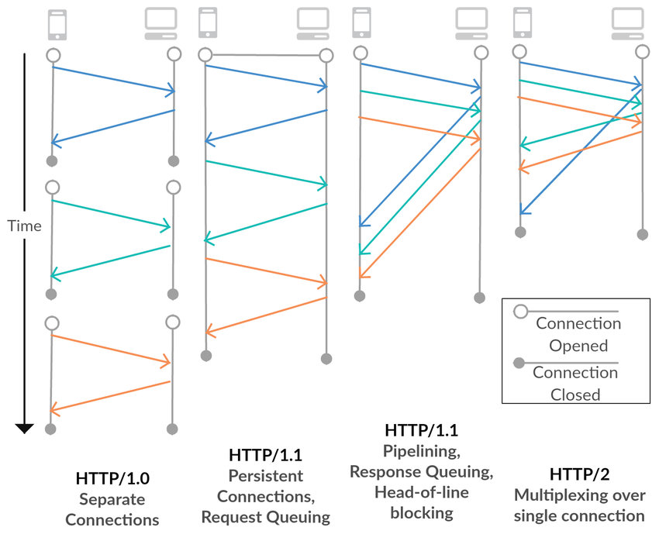

HTTP Versions
HTTP/0.9 – Released in 1991. Basic request response communication, only one method ‘GET’
HTTP/1.0 – Release in 1996. Added additional request methods, headers and status code
HTTP/1.1 – Release in 1999. Better performance and scalability
HTTP/2.0 – Release in 2015. significant performance improvements. Introduces binary encoding, server push and header compression
Notes:
HTTP/0.9 Няма headers или status codes.
HTTP/1.0 It was not well suited for modern web applications due to its limited performance and scalability
HTTP/1.1 support for persistent connections, improved support for caching, and many other enhancements.
Netscape created HTTPS in1994 for its Netscape navigator web browser using SSL protocol. Google started encouraging sites to go to HTTPS in 2010.

Slide 8

REST
REST stands for representational state transfer, which is a web architecture style used to create scalable and efficient web services.
Principles:
Client-server Architecture
Statelessness
Cacheability
Layered System
Uniform Interface.
Notes:
REST is based on a few principles, including client-server architecture, statelessness, cacheability, layered system, and uniform interface.
Client-server architecture: The client and server are separated, and each has its own responsibilities.
Statelessness: Each request from the client to the server must contain all the necessary information, and the server cannot store any state about the client.
Cacheability: Responses from the server should be cacheable to improve performance.
Layered system: The system is composed of layers, with each layer only knowing about the layer above and below it.
Uniform interface: The interface should be uniform across all resources, using standard HTTP methods like GET, POST, PUT, and DELETE.

Slide 9
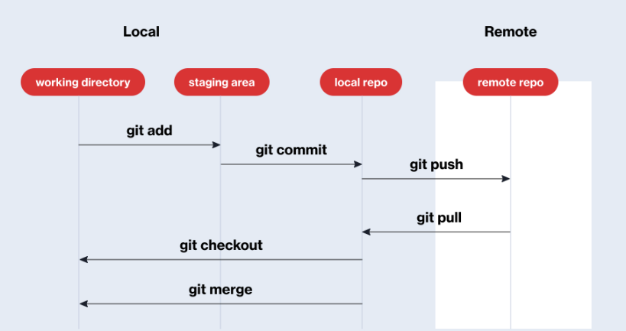
Git & GitHub
Git is a version control system that allows developers to track changes in their code over time, collaborate with other developers, and revert to previous versions of their code
GitHub is a web-based platform that allows developers to host their git repositories and collaborate with others. It provides a number of features such as pull requests, issue tracking, and project management tools that make it easier for developers to work together on a project.
Notes:
Continuous Integration (CI) and Continuous Delivery (CD)

Slide 10
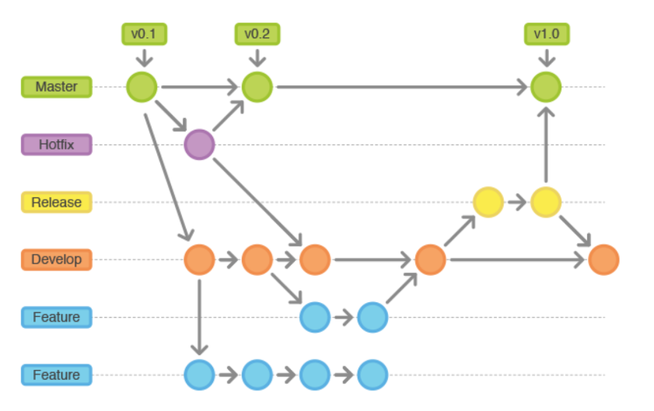
Branching Strategies

Slide 11

Controllers & Actions
Controllers handle incoming requests and call specific actions to perform tasks. Actions perform specific tasks in response to the request and return data to the controller to generate a response. Well-designed controllers and actions create efficient and maintainable applications.
www.example.com/product/details/5

Slide 12

Cookies & JSON Web Tokens (JWT)
Cookies
Cookies are small text files stored on a client's device by a web browser. They are sent from the client to the server with each HTTP request.
JSON Web Tokens (JWT)
JWT are a compact, encrypted format for transmitting information such as user credentials, timestamps, or other data. They are stored on the client side as a string and must be included in the header of each request to the server. JWT are generally considered more secure than cookies, as they are signed and encrypted, but can become invalid if the server's secret key is compromised.
Notes:
Cookies and JSON Web Tokens (JWT) are methods for storing and transmitting information between a client and a server in a web application.
Cookies are small text files stored on a client's device by a web browser. They contain information such as login credentials, preferences, or shopping cart contents, and are sent from the client to the server with each HTTP request.
JWT are a compact, encrypted format for transmitting information such as user credentials, timestamps, or other data. They are stored on the client side as a string and must be included in the header of each request to the server. JWT are generally considered more secure than cookies, as they are signed and encrypted, but can become invalid if the server's secret key is compromised.

Slide 13
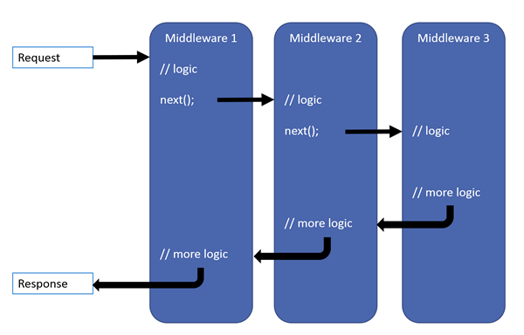

ASP.Net Middleware
In .NET core, middleware is a type of software component that is used to handle HTTP requests and responses. Middleware sits between the web server and the application and can perform a variety of tasks, such as authentication, caching, logging, compression, routing, and more.
Built-in Middleware
Authentication Middleware
Routing Middleware
Static Files Middleware
Response Caching Middleware
Notes:
Authentication middleware: Provides support for authenticating users based on various schemes such as JWT, cookies, OAuth2, etc.
Routing middleware: Maps incoming requests to appropriate endpoints based on a set of predefined rules.
Static files middleware: Enables serving static files such as HTML, CSS, and JavaScript files directly from the web server.
Response caching middleware: Adds caching headers to HTTP responses to improve performance by reducing server load.
Compression middleware: Compresses response data to reduce the amount of data transferred over the network.

Slide 14

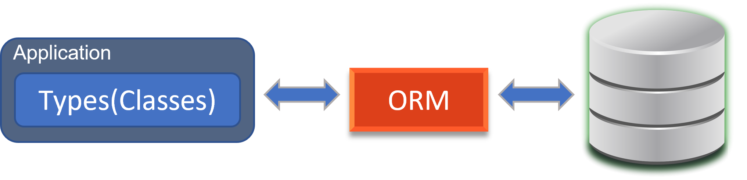
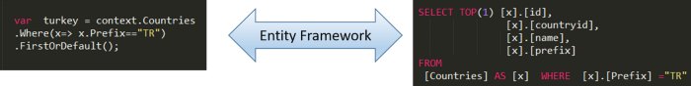
ORM
OBJECT-RELATIONAL MAPPING
Technique for converting data between incompatible type systems in object-oriented programming languages.
ENTITY FRAMEWORK CORE
An enhancement to ADO.NET that gives developers an automated mechanism for accessing and storing the data in the database.
Notes:
Entity Framework (EF) Core е олекотена, разширена, open source и cross-platform версия на Entity Framework
Позволява .NET developers да работят с базата използвайки .NET objects (class).
Има и други ORM-и за .NET като DataObjects.Net, NHibernate, OpenAccess, SubSonic etc.
Специфичното е че се използва за Релационни бази данни

Slide 15
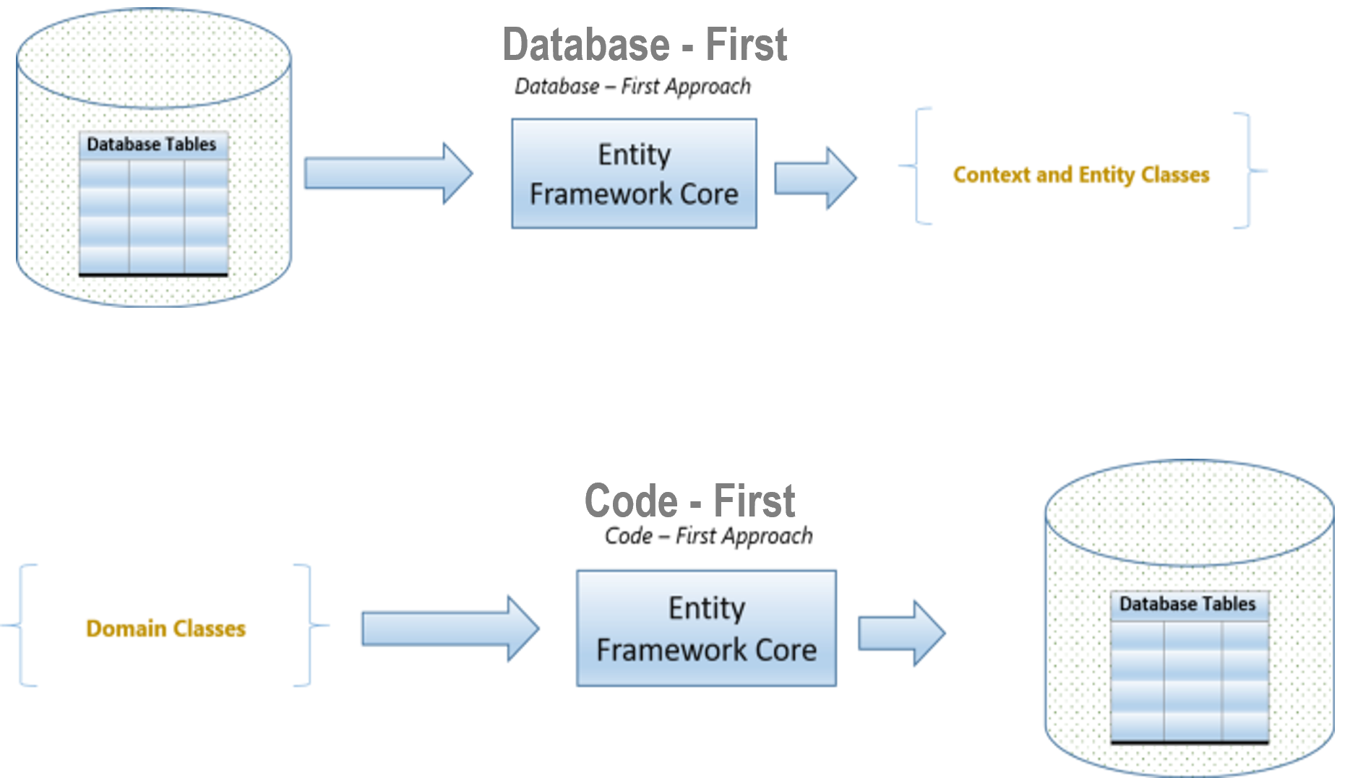

Approaches

Slide 16


Slide 17


Lyubomir Ganchev
Senior Full Stack .Net developer
Lyubomir.ganchev@endava.com
Vladimir Ignatov
Full Stack .Net developer
Vladimir.ignatov@endava.com

